Slide 1








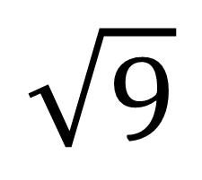
My Angles
Interactive Notebook
Name
Class:
Teacher:
Term 4 Semester 2

Slide 2
Contents
Glossary or Formula Page
Page
Date
Description
2

Slide 3
Tasks
24
7
30
Essential Question
Questions
Notes
Summary
6

Slide 4
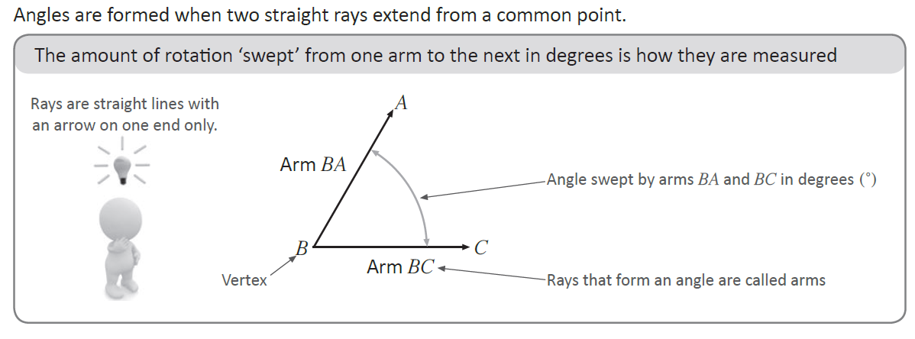
24
7
30
Date
Topic: Parts of an angle and naming angles
EQ – How do I name an angle?

Slide 5
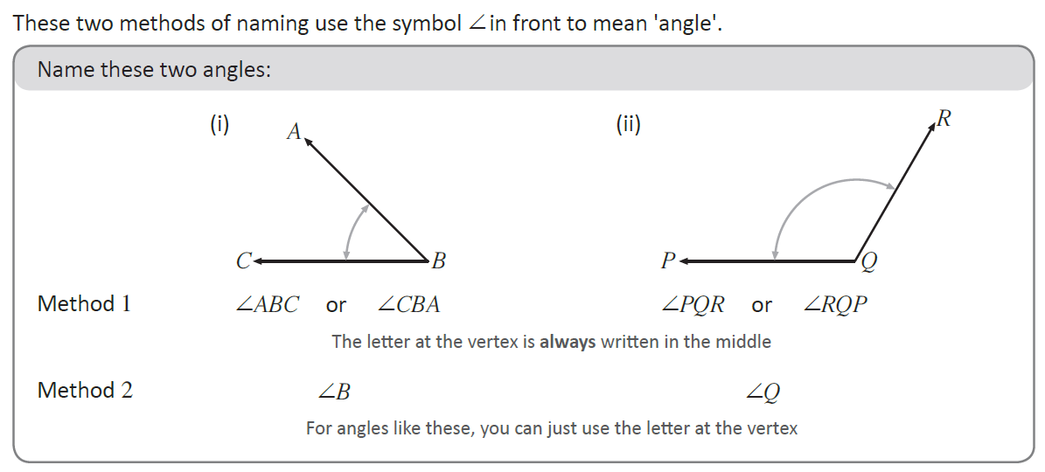
24
7
30
Date
Topic: Parts of an angle and naming angles
EQ – How do I name an angle?

Slide 6
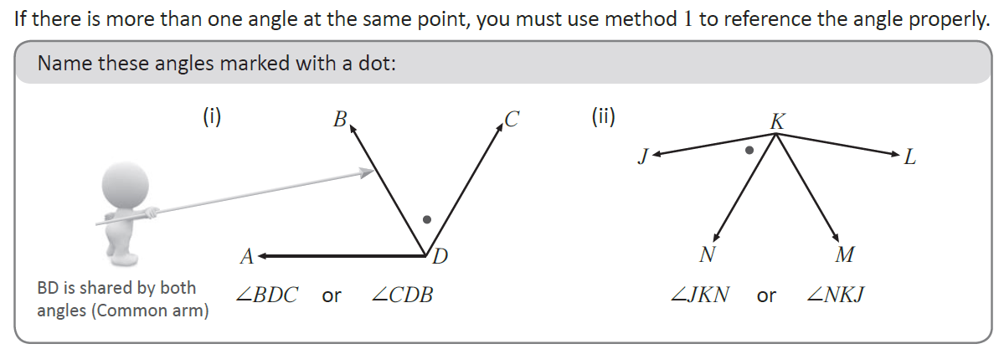
24
7
30
Date
Topic: Parts of an angle and naming angles
EQ – How do I name an angle?

Slide 7
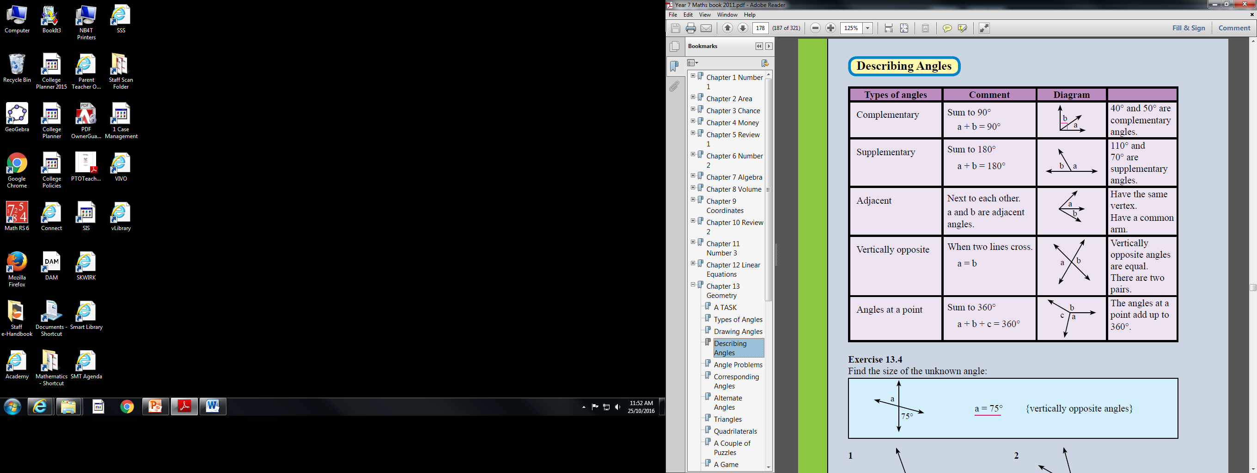
24
7
30
Date
Topic: Parts of an angle and naming angles
EQ – How do I describe an angle?

Slide 8
24
7
30
Date
Topic: Parts of an angle and naming angles
EQ – How do I describe an angle?
Exercise 13.4
Page 178

